Slide 1

The problem of overfitting
Regularization
Machine Learning

Slide 2
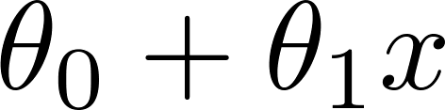
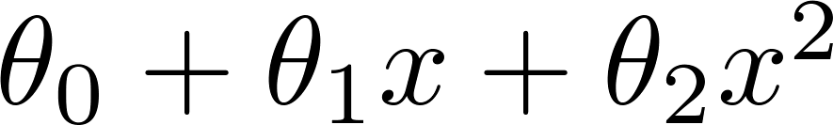
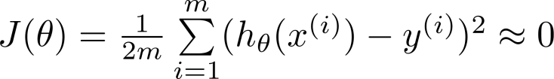
Example: Linear regression (housing prices)
Price
Price
Price
Size
Size
Size
“Underfitting”
High bias
“Just right”
“Overfitting”
High variance
Overfitting: If we have too many features, the learned hypothesis may fit the training set very well ( ), but fail to generalize to new examples (predict prices on new examples).

Slide 3
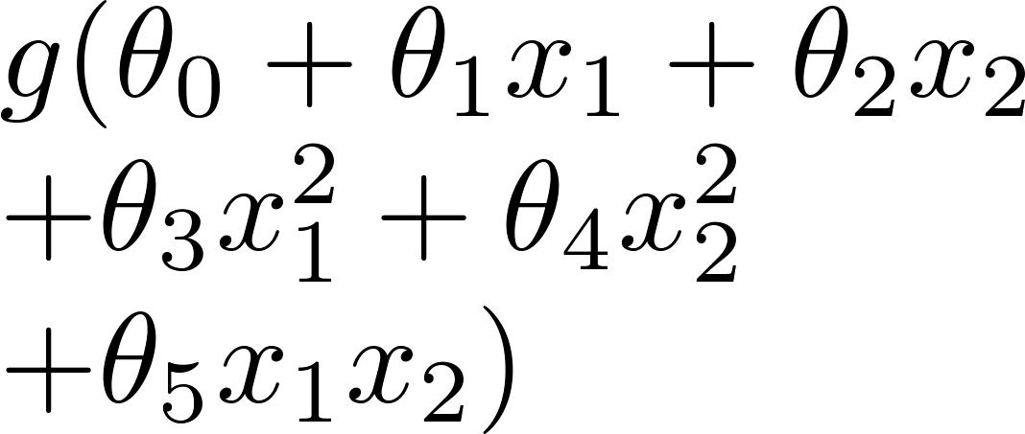
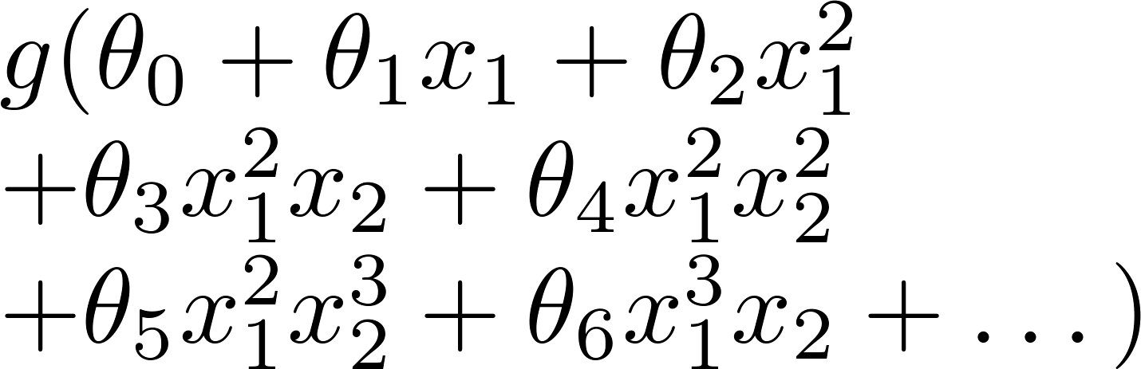
Example: Logistic regression
x₂
x₂
x₂
x₁
x₁
x₁

Slide 4






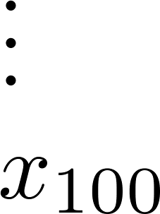
Addressing overfitting:
size of house
no. of bedrooms
Price
no. of floors
age of house
average income in neighborhood
Size
kitchen size

Slide 5


Addressing overfitting:
Options:
Reduce number of features.
Manually select which features to keep.
Model selection algorithm (later in course).
Regularization.
Keep all the features, but reduce magnitude/values of parameters .
Works well when we have a lot of features, each of which contributes a bit to predicting .

Slide 6
Cost function
Regularization
Machine Learning

Slide 7


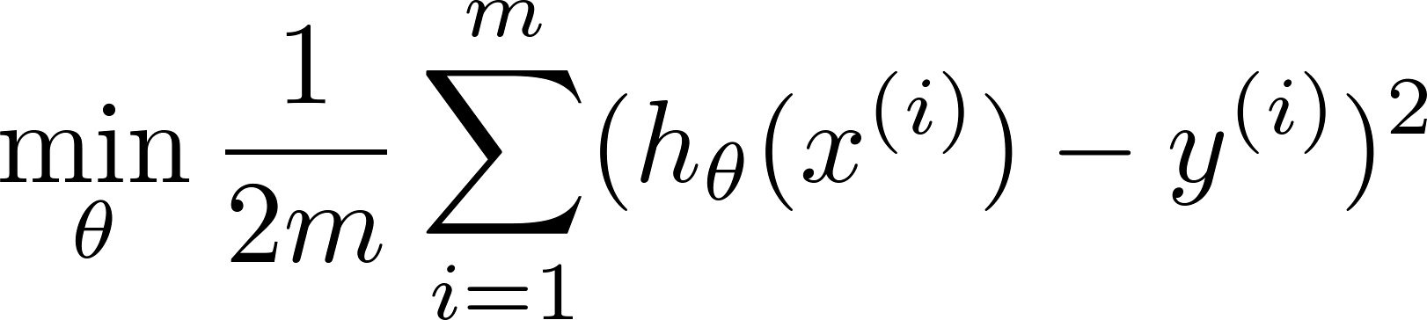
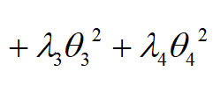

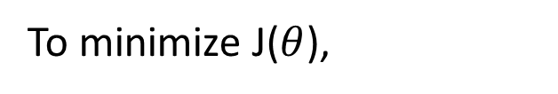
Intuition
Price
Price
Size of house
Size of house
Suppose we penalize and make , really small.
$$θ_{3}→0,θ_{4}→0$$
To minimize J($θ$),

Slide 8
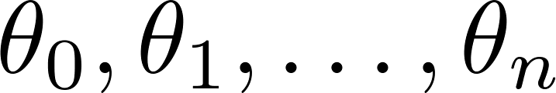
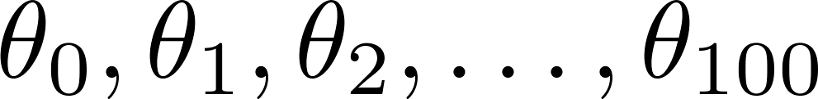
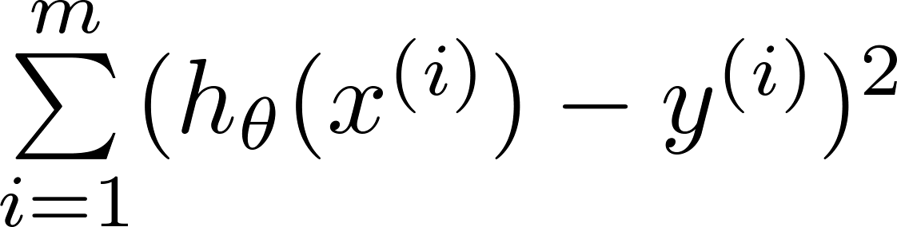
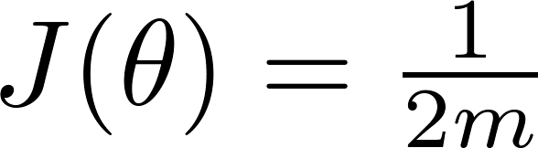
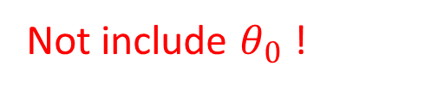

Regularization.
Small values for parameters
“Simpler” hypothesis
Less prone to overfitting
Housing:
Features:
Parameters:
$$+ λ\sum_{j=1}^{n}{θ_{j}^{2}}$$
Not include $θ_{0}$ !

Slide 9
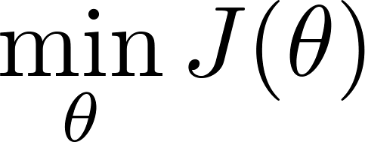
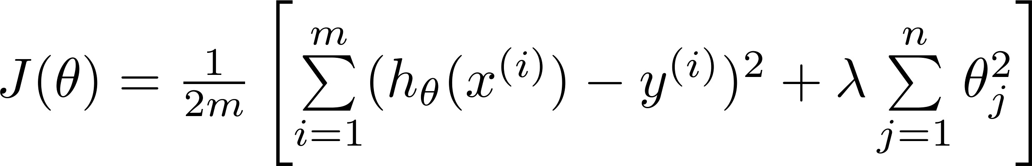


Regularization.
$$θ_{j}$$
Regularization term: to minimize
Object term: to fit training data
$$λ：Regularization Parameter$$
Find a trade-off between object term and regularization term, to avoid overfitting

Slide 10


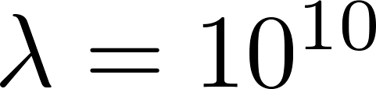

In regularized linear regression, we choose to minimize
What if is set to an extremely large value (perhaps for too large for our problem, say )?
Price
Size of house

Slide 11
In regularized linear regression, we choose to minimize
What if is set to an extremely large value (perhaps for too large for our problem, say )?
Algorithm works fine; setting to be very large can’t hurt it
Algortihm fails to eliminate overfitting.
Algorithm results in underfitting. (Fails to fit even training data well).
Gradient descent will fail to converge.

Slide 12
Regularized linear regression
Regularization
Machine Learning

Slide 13
Regularized linear regression

Slide 14

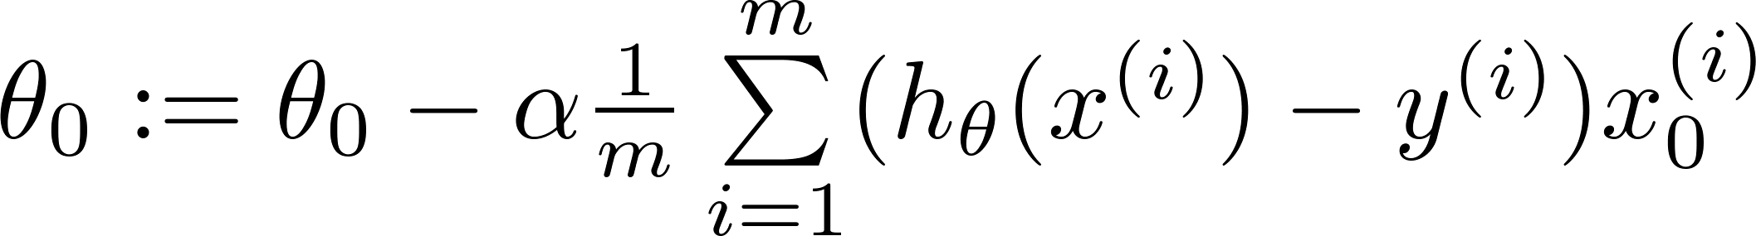
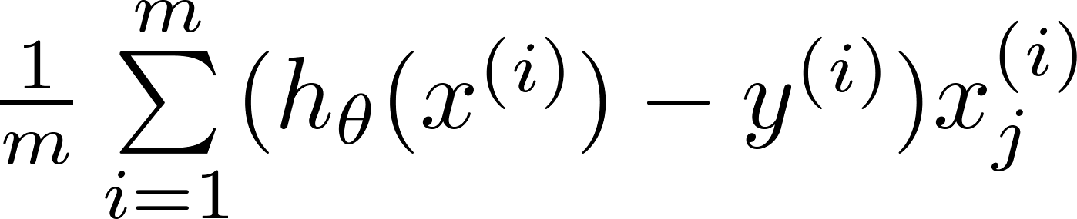
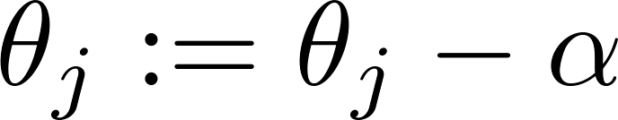


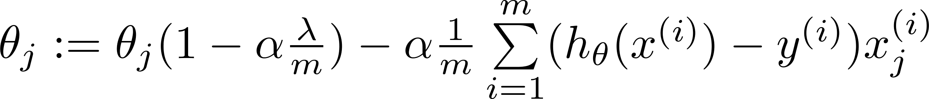

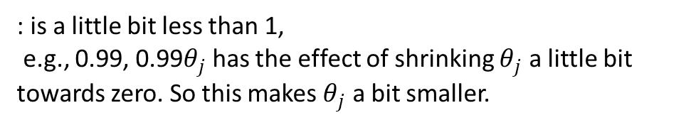
Gradient descent
Repeat
: is a little bit less than 1,
e.g., 0.99, 0.99$θ_{j}$ has the effect of shrinking $θ_{j}$ a little bit towards zero. So this makes $θ_{j}$ a bit smaller.

Slide 15
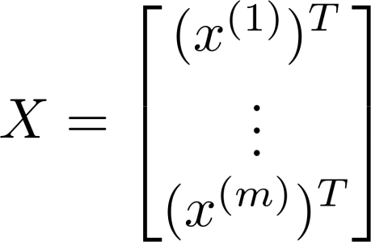
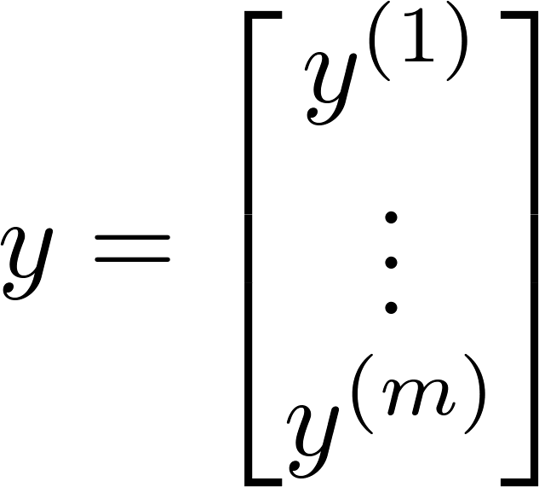
Normal equation

Slide 16
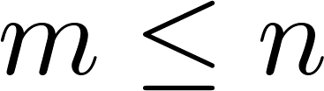
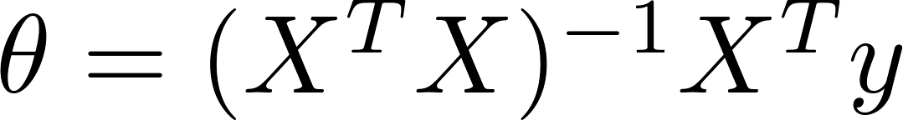

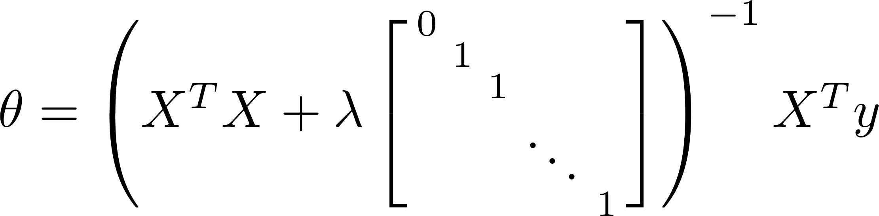
Non-invertibility (optional/advanced).
Suppose ,
(#examples) (#features)
If ,

Slide 17
Regularized logistic regression
Regularization
Machine Learning

Slide 18
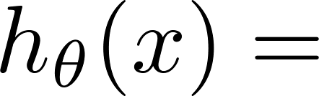
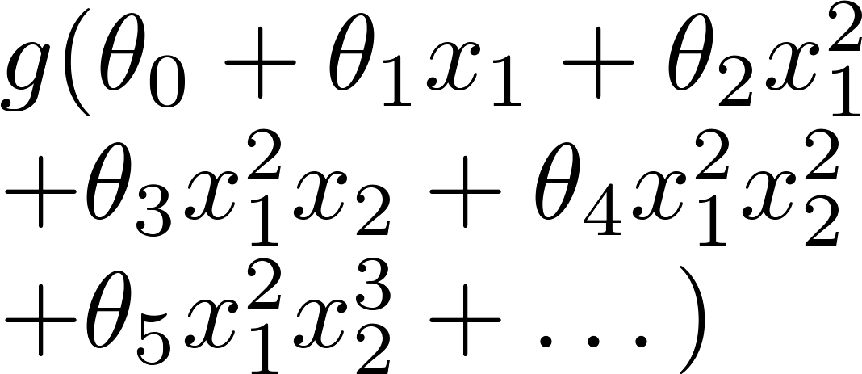
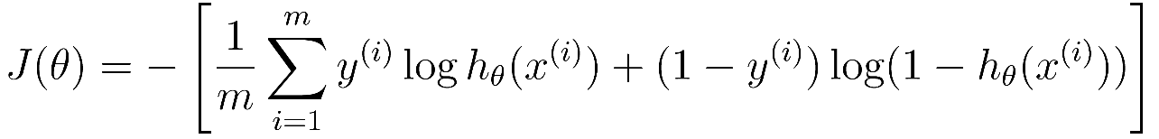
Regularized logistic regression.
x₂
x₁
Cost function:

Slide 19
Gradient descent
Repeat

Slide 20





Advanced optimization
function [jVal, gradient] = costFunction(theta)
code to compute
jVal = [ ];
code to compute
gradient(1) = [ ];
code to compute
gradient(2) = [ ];
code to compute
gradient(3) = [ ];
code to compute
gradient(n+1) = [ ];

Slide 21
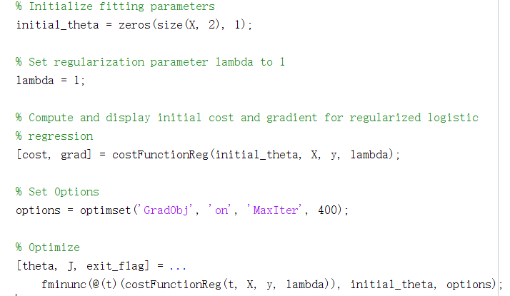

Slide 22
第5章 正则化重点
什么是欠拟合?什么是过拟合？如何改善过拟合？
带有正则化的线性回归的假设函数、代价函数、优化目标、梯度下降
带有正则化的逻辑回归的假设函数、代价函数、优化目标、梯度下降
当正则化参数 取值过大或过小时会发生什么情况？

